Slide 1
Cat Classifier

Slide 2
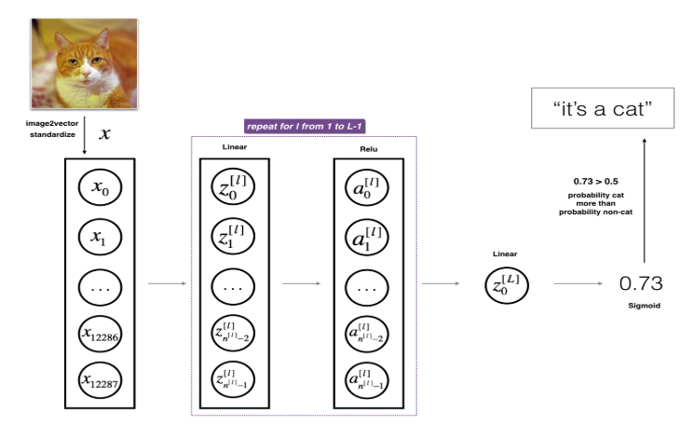
4- layer n/w
Network Structure:
Input layer: 12288 units (64 *64 * 3)
Layer_1: 20 units
Layer_2: 7 units
Layer_3: 5 units
Layer_4 (Output layer): 1 unit
Summary:
[LINEAR -> RELU] ×3 times ->
LINEAR -> SIGMOID
Input layer takes 64*64*3 image

Slide 3
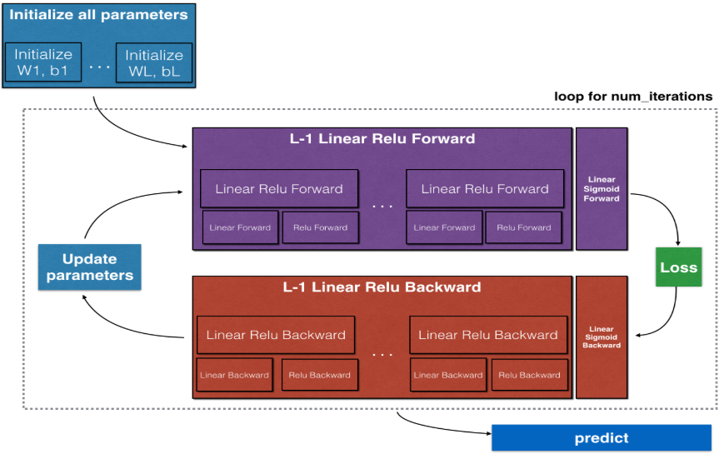

Slide 4

Hyper Parameters
Learning rate = 0.0075
# iterations = 2500

Slide 5
Vector sizes and other details
Number of training examples: 209
Number of testing examples: 50
Each image is of size: (64, 64, 3)
train_x_orig shape: (209, 64, 64, 3)
train_y shape: (1, 209)
test_x_orig shape: (50, 64, 64, 3)
test_y shape: (1, 50)
train_x's shape: (12288, 209)
test_x's shape: (12288, 50)

Slide 6

Cost/Loss of the model Cost after iteration 100: 0.672053 Cost after iteration 500: 0.540138 Cost after iteration 1000: 0.315187 Cost after iteration 1500: 0.161189 Cost after iteration 2000: 0.113821 Cost after iteration 2500: 0.092878
Cost function :
Cost after iteration 0: 0.771749
Cost after iteration 100: 0.672053
Cost after iteration 200: 0.648263
Cost after iteration 300: 0.611507
Cost after iteration 400: 0.567047
Cost after iteration 500: 0.540138
Cost after iteration 600: 0.527930
Cost after iteration 700: 0.465477
Cost after iteration 800: 0.369126
Cost after iteration 900: 0.391747
Cost after iteration 1000: 0.315187
Cost after iteration 1100: 0.272700
Cost after iteration 1200: 0.237419
Cost after iteration 1300: 0.199601
Cost after iteration 1400: 0.189263
Cost after iteration 1500: 0.161189
Cost after iteration 1600: 0.148214
Cost after iteration 1700: 0.137775
Cost after iteration 1800: 0.129740
Cost after iteration 1900: 0.121225
Cost after iteration 2000: 0.113821
Cost after iteration 2100: 0.107839
Cost after iteration 2200: 0.102855
Cost after iteration 2300: 0.100897
Cost after iteration 2400: 0.092878

Slide 7
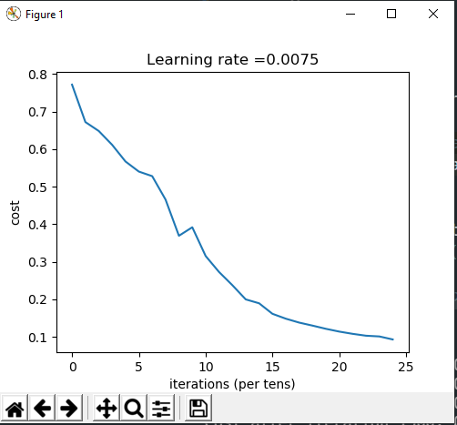
Cost graph

Slide 8


Observed Results
Training accuracy : 0.9856459330143539
Testing accuracy: 0.8

Slide 9
A few types of images the model tends to do poorly on
Cat body in an unusual position
Cat appears against a background of a similar color
Unusual cat color and species
Camera Angle
Brightness of the picture
Scale variation (cat is very large or small in image)

